Slide 1
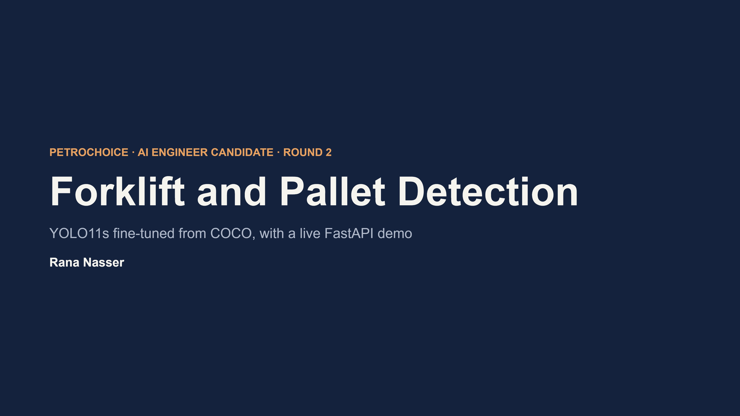
Forklift and Pallet Detection
YOLO11s fine-tuned from COCO, with a live FastAPI demo
Rana Nasser
PETROCHOICE · AI ENGINEER CANDIDATE · ROUND 2

Slide 2
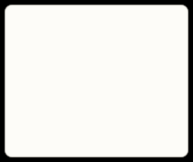
AGENDA
What this presentation covers
Approach
1
Problem framing and model choice
Implementation
2
Data pipeline, training and evaluation setup
Key technical decisions
3
What was chosen, why, and the evidence
Final outcome
4
Results, errors, deployment and live demo
Then: Done, limitations and next steps .
Forklift and Pallet Detection ·

Slide 3
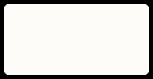
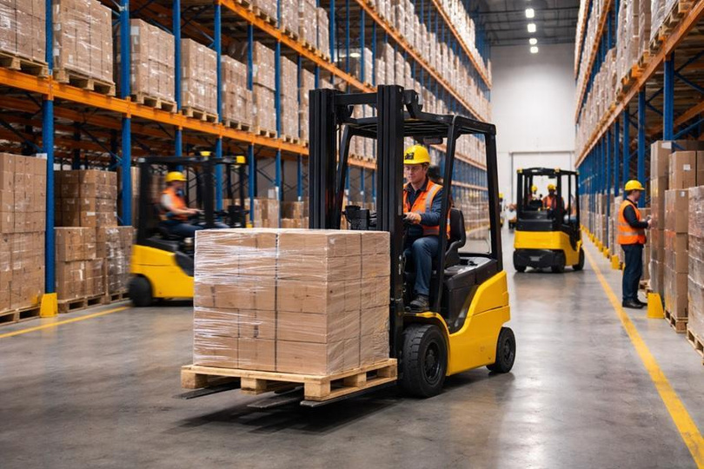
APPROACH
What a forklift and pallet detector enables
Safety
Warnwhen a forklift enters a walking zone
Automation
Guide autonomous forklifts to the right pallet
Inventory
Count pallets without manual stock checks
Efficiency
Measureforklift use and dock activity
Task: object detection on warehouse images. Output: a box, a class and a confidence for every object. Classes: forklift and pallet, empty or loaded. Boxes are enough for counting and zones, and far cheaper to label than masks.
Forklift and Pallet Detection ·

Slide 4

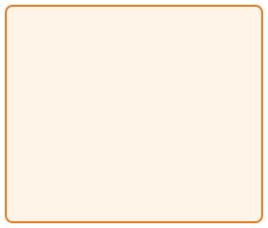
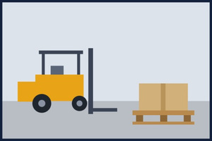
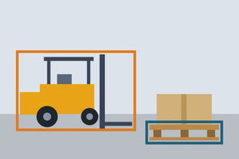

TASK TYPE
Our problem is detection: what is where
Classification
Detection
Our task
Segmentation
What is in the image? One label for the whole image, no position.
What is where? A box, a class and a confidence for each object.
Which pixels belong to each object? Slower, and labels cost far more.
Forklift and Pallet Detection ·

Slide 5
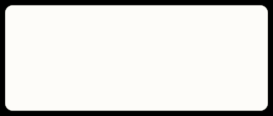


THE TASK
Detect forklifts and pallets in warehouses
Input
Output
Classes
Warehouse images and video frames
A box, a class and a confidence for every object
forklift and pallet, empty or loaded
Why it is hard
•Small, distant and partly hidden pallets
•Look-alikes: pallet trucks, stillages, small load carriers •Public data that may not match the target warehouse
Forklift and Pallet Detection ·

Slide 6
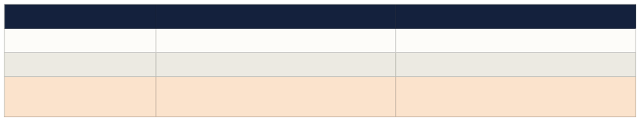
APPROACH
A single-stage YOLO11 detector, fine-tuned from COCO
Option
Two-stage (Faster R-CNN) Transformer (RT-DETR) YOLO11 (chosen)
Strength
Strong accuracy, good on small objects No NMS step, strong accuracy
Real-time, mature tooling, COCO weights, simple ONNX export
Trade-off
Slower and heavier to deploy
Heavier, needs more data and compute Less accurate on tiny objects than larger models
Tools: Python, Ultralytics YOLO, PyTorch, Kaggle Notebooks, with transfer learning from COCO weights. YOLO11n is the lightweight baseline and YOLO11s is compared against it. The choice is revisited on accuracy, speed and hardware.
Forklift and Pallet Detection ·

Slide 7



IMPLEMENTATION
From raw datasets to a working service
Audit and filter
1
Merge two datasets, keep two classes, validate every label
Split
2
Train, validation and test with a near- duplicate check
Train
3
YOLO11n and YOLO11s from COCO weights at 768 px
Evaluate
4
Select on validation, test once, per-class and error analysis
Deploy
5
ONNX export and a FastAPI demo with saved reports
Forklift and Pallet Detection ·

Slide 8
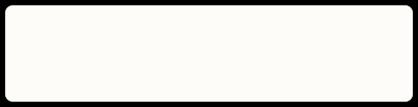

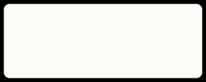
IMPLEMENTATION: DATA
Two public datasets, filtered to two classes
Warehouse (Roboflow Universe)
1,075 images, 5classes.11,776palletboxes but only 5 forklift boxes in train.
Forklift (Kaggle)
1,011 images,classesforklift and person. 1,000 forklift boxes in train, no pallets.
1,660
213
187
train images
validation images
test images
Rules: exact class-name match (pallet_truck is never pallet), removed classes become background, 80 hard-negative images kept, 3 untrusted images dropped, polygons converted to boxes. Near-duplicate check: 0 images removed.
Forklift and Pallet Detection ·

Slide 9


IMPLEMENTATION: DATA
Three data problems and how each is handled
Class imbalance
12 : 1
palletboxes per forklift box (13,275 against1,101). Fix: forklift images repeated up to 3 times and class- weighted loss (power 0.5). AP is reported per class.
Labels missing across sources
0
pallet boxes in the forklift dataset, and only 5 forklift boxes in the warehouse one. Handled: errors reported per source. Pseudo-labelling exists but is off in the final run.
Small objects
70.4%
ofallboxes cover under 1% of the image. Fix: 768px input keeps small pallets visible,and recall is reported by object size.
Forklift and Pallet Detection ·

Slide 10
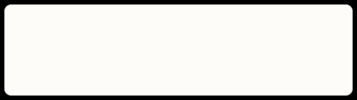
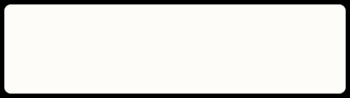

TRAINING
Same data, two model sizes, one honest selection
Models
Settings
YOLO11n and YOLO11s, COCO-pretrained, fine-tuned on the merged data
768 px images, up to 80 epochs, early stopping, cosine learning rate, fixed seed
Augmentation
Selection
Mosaic off for the last 10 epochs. No vertical flip, because an upside-down forklift is unrealistic
Model and confidence threshold are chosen on validation. The test set is used once.
Forklift and Pallet Detection ·

Slide 11

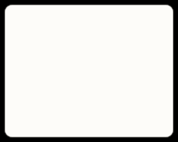
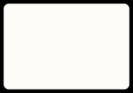
ARCHITECTURE
YOLO11: one pass from image to boxes
Backbone
Neck
Head
Input
Convolution blocks and attention extract features
Anchor-free box and class branches, then NMS
No anchor tuning, one pass
Image resized to 768 px Keeps small pallets visible
Mixes features from three scales
Small pallets and big forklifts in one model
COCO weights already know vehicles
Why YOLO11: real-time speed, simple ONNX export, and COCO pretraining lets fine-tuning work with about 2,000 images.
Forklift and Pallet Detection ·

Slide 12
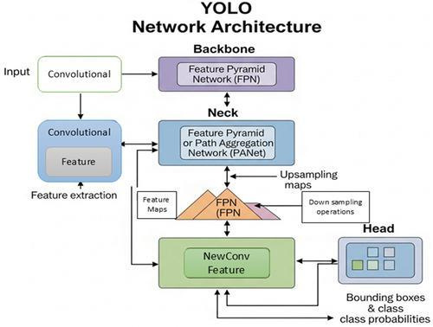
ARCHITECTURE
YOLO11: one pass from image to boxes
Forklift and Pallet Detection ·

Slide 13
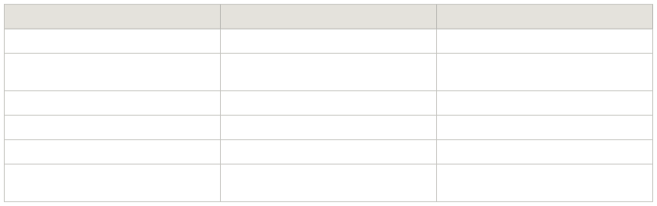
KEY TECHNICAL DECISIONS
What was chosen, why, and the evidence
Decision
Why
Evidence
YOLO11, single-stage
Real-time, COCO weights, simple ONNX export
210 ms per image on CPU with ONNX
768 px input
70% of boxes cover under 1% of the image
Small pallets are still the weakest case (62.5% found)
Repeat forklifts x3, class-weighted loss
About 12 pallet boxes per forklift box
Forklift AP50 0.902, no class mix-ups
Select on validation, test once
No tuning to the test set
YOLO11s 0.491 against 0.476 val mAP50-95
NMS IoU 0.7, confidence 0.35
Best mAP50-95 and best F1 on validation
0.491 at IoU 0.7, 0.476 at 0.5
ONNX for serving
Faster, no PyTorch needed
210 ms against 254 ms, mAP50-95 0.532 against 0.540
Forklift and Pallet Detection ·

Slide 14
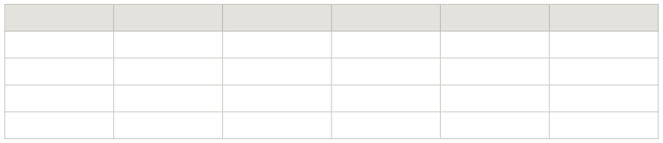
FINAL OUTCOME: RESULTS
YOLO11s is selected on validation; both reach mAP50 above 0.83
Model YOLO11n YOLO11n YOLO11s YOLO11s
Split val test val test
mAP50 0.830 0.875 0.838 0.863
mAP50-95 0.476 0.548 0.491 0.540
Precision 0.855 0.869 0.867 0.826
Recall 0.773 0.806 0.778 0.793
YOLO11s has the higher validation mAP50-95 (0.491 against 0.476), so it is selected. On test the two sizes are close. Test-time augmentation raised validation mAP50-95 to 0.507 but more than doubled inference time, so it is not used.
Forklift and Pallet Detection ·

Slide 15
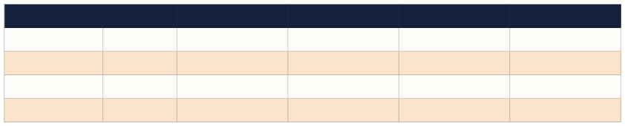
RESULTS
Both sizes reach mAP50 above 0.85 on the test set
Model YOLO11n YOLO11n YOLO11s YOLO11s
Split val test val test
mAP50 0.830 0.875 0.838 0.863
mAP50-95 0.476 0.548 0.491 0.540
Precision 0.855 0.869 0.867 0.826
Recall 0.773 0.806 0.778 0.809
YOLO11s has the higher validation mAP50-95 (0.491 against 0.476), so it is selected. On test the two sizes are close.
Test-time augmentation raised validation mAP50-95 to 0.507 but more than doubled inference time, so it is not used.
Forklift and Pallet Detection · first run, 640 px, before class balancing

Slide 16
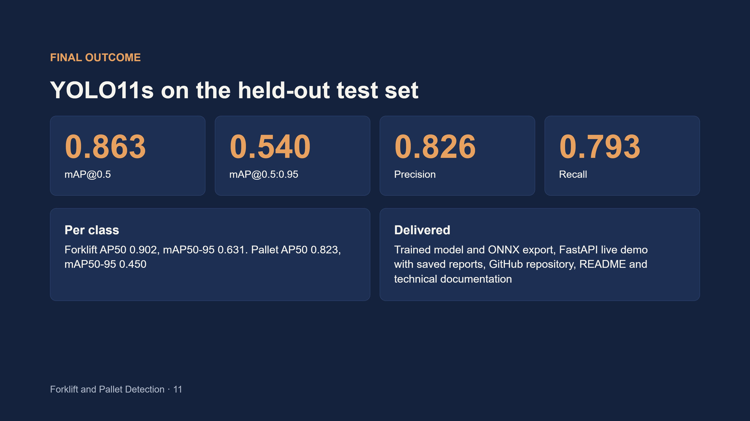
FINAL OUTCOME
YOLO11s on the held-out test set
0.863
mAP@0.5
0.540
mAP@0.5:0.95
0.826
Precision
0.793
Recall
Per class
Delivered
Forklift AP50 0.902, mAP50-95 0.631. Pallet AP50 0.823, mAP50-95 0.450
Trained model and ONNX export, FastAPI live demo with saved reports, GitHub repository, README and
technical documentation
Forklift and Pallet Detection · 11

Slide 17
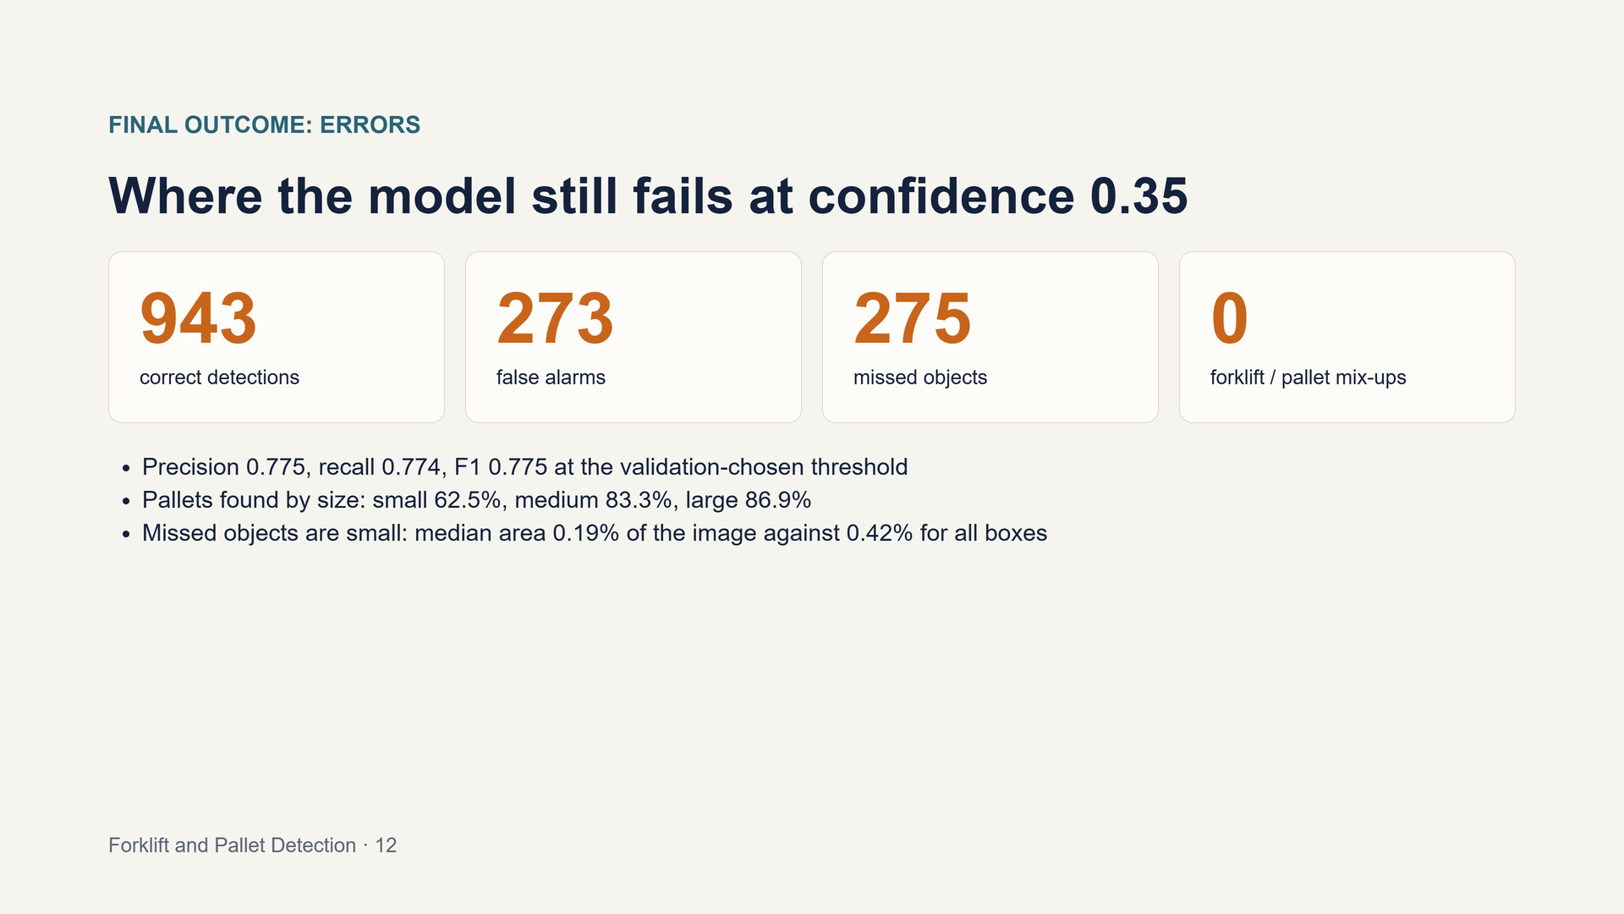
FINAL OUTCOME: ERRORS
Where the model still fails at confidence 0.35
943
correct detections
273
false alarms
275
missed objects
0
forklift / pallet mix-ups
Precision 0.775, recall 0.774, F1 0.775 at the validation-chosen threshold
Pallets found by size: small 62.5%, medium 83.3%, large 86.9%
Missed objects are small: median area 0.19% of the image against 0.42% for all boxes
Forklift and Pallet Detection · 12

Slide 18
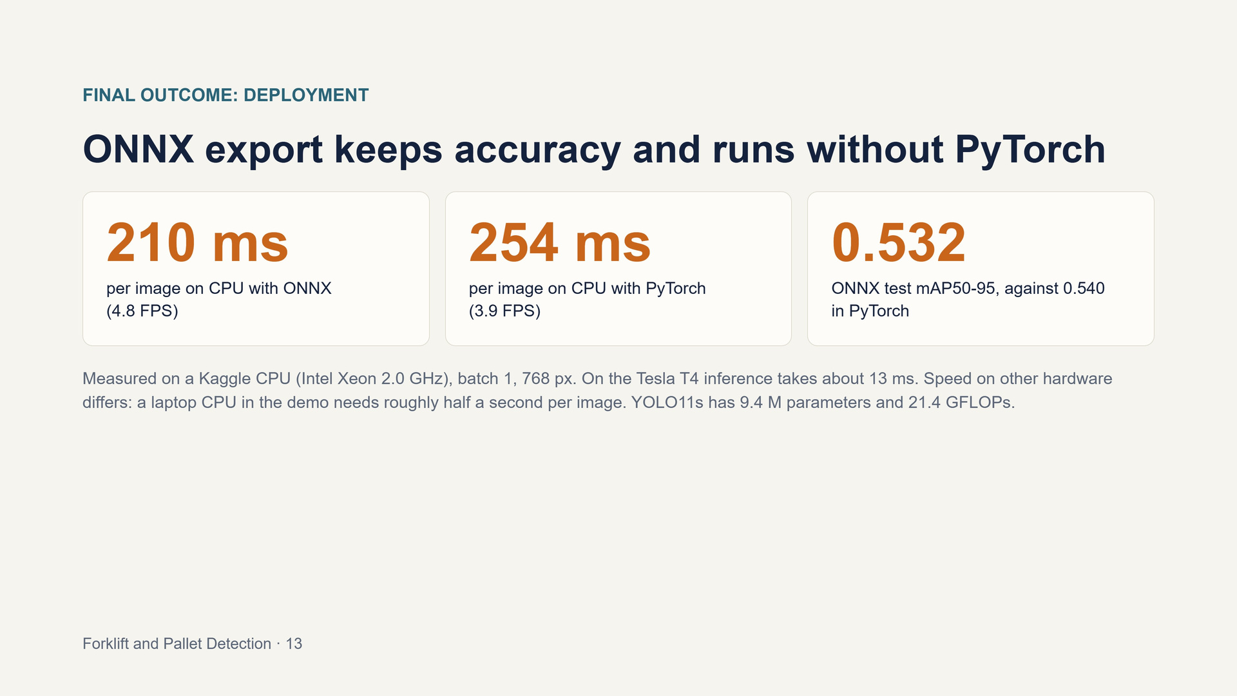
FINAL OUTCOME: DEPLOYMENT
ONNX export keeps accuracy and runs without PyTorch
210 ms
per image on CPU with ONNX
(4.8 FPS)
254 ms
per image on CPU with PyTorch
(3.9 FPS)
0.53
ONNX test mAP50-95, against 0.540
in PyTorch
Measured on a Kaggle CPU (Intel Xeon 2.0 GHz), batch 1, 768 px. On the Tesla T4 inference takes about 13 ms. Speed on other hardware
differs: a laptop CPU in the demo needs roughly half a second per image. YOLO11s has 9.4 M parameters and 21.4 GFLOPs.
Forklift and Pallet Detection · 13

Slide 19
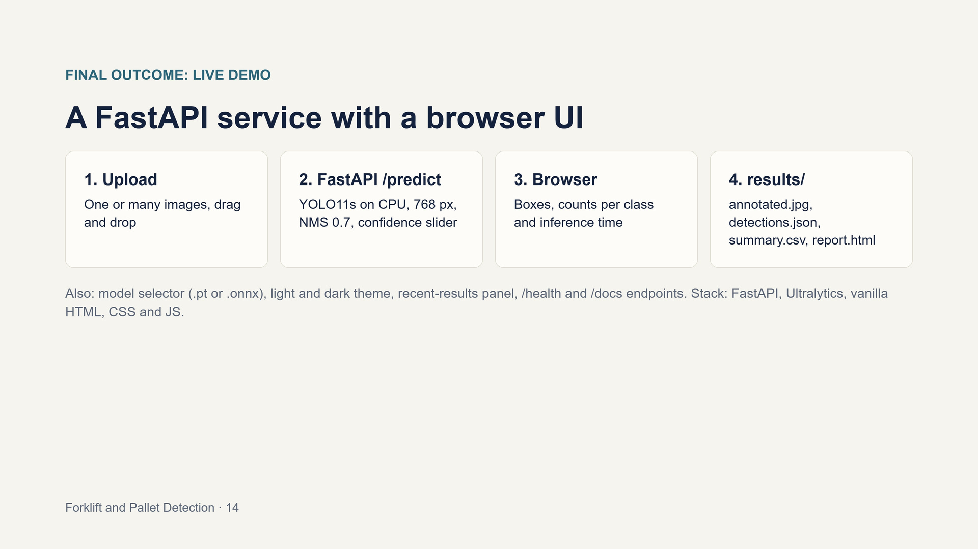
FINAL OUTCOME: LIVE DEMO
A FastAPI service with a browser UI
1. Upload
One or many images, drag
and drop
2. FastAPI /predict
YOLO11s on CPU, 768 px, NMS 0.7, confidence slider
3. Browser
Boxes, counts per class
and inference time
4. results/
annotated.jpg, detections.json, summary.csv, report.html
Also: model selector (.pt or .onnx), light and dark theme, recent-results panel, /health and /docs endpoints. Stack: FastAPI, Ultralytics, vanilla
HTML, CSS and JS.
Forklift and Pallet Detection · 14

Slide 20


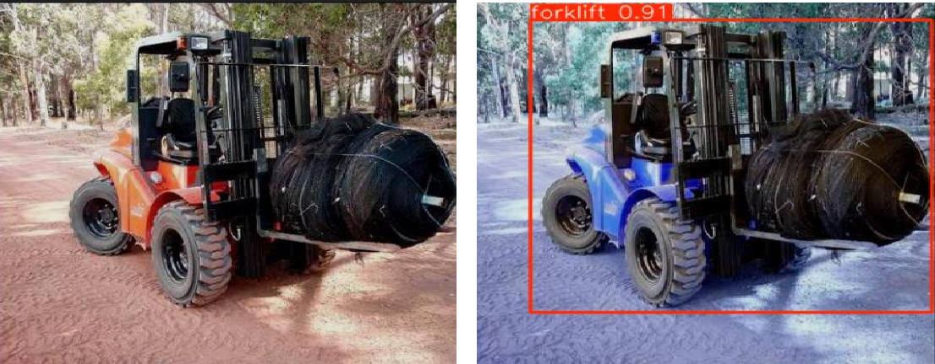
VISUAL RESULTS
Predictions next to the labels
•Source: s0_forklift
•Image: rep1_s0_forklift__01FVZIGPUGWI_jpg.rf.272f9ea3336a11f2c4390ccc97244242.jpg •Detections: 1
•Class: forklift | Confidence: 0.907
Forklift and Pallet Detection ·

Slide 21


CONCLUSION
Done so far, and what comes next
Done
Next (proposed)
•Two datasets merged, filtered to two classes and audited •Train, validation and test splits without near-duplicate
1.Label real Petrochoice frames and review the pseudo-
labels
•YOLO11n and YOLO11s trained and compared •Per-class evaluation and error analysis
2.Improve data and model iteratively, with active learning 3.Validate on representative warehouse data
4.Optimize for the target hardware, then consider
•Deploy on FsstAPI and HTML CSS JS
deployment once targets are met
Limitations
Public images may differ from Petrochoice cameras. Small and hidden pallets are the weak spot. Sources label one class each. The test set is small. Ultralytics is AGPL-3.0, check dataset licenses.
Forklift and Pallet Detection

Slide 22
PETROCHOICE · AI ENGINEER CANDIDATE · ROUND 2
Thank you.
Questions?
Rana Nasser

